Slide 1

Course Name: Hardware Security
Faculty Name: Prof Debdeep Mukhopadhyay
Department : Computer Science and Engineering
Topic
Lecture 26: Power Analysis-II

Slide 2

Concepts Covered:
Difference-of-Mean (DOM) Method
DOM on AES
Selection Function
DOM on actual power traces on AES, DES, 3-DES
Summary of DOM

Slide 3
DPA Procedure for AES
1. Make power consumption measurement of about 1000 AES operations, 100000 data points / curve, (Ciphertext_{i}, Curve_{i})
2. Assume a key for an S-box of last round
3. Calculate last round S-box first bit output for each ciphertext using the assumed key
4. Divide the measurement into 2 groups (output 0 and 1)
5. Calculate the average curve of each group
6. Calculate the difference of two curves
7. Assumed correct key → spikes in the differential curve
8. Repeat 2-7 for other S-boxes
Exhaustive search for 8 bits of key.

Slide 7
Difference-of-Mean (DOM) Method
DPA selection function : D(C,b,K_{s}) is defined as computing the value of the
b^{th} output bit, depending upon
C: Ciphertext
K_{S} is the guessed key (6 bits) for the S-Box
Note: If K_{s} is incorrect evaluating D(…) gives the correct bit in half of the cases for each of the ciphertexts.

Slide 8
DOM (Contd.)
Attacker obtains m encryption operations and capture power traces, T_{1..m}[1..k], with k sample points each.
An attacker records the m ciphertexts
No knowledge of the plaintext is required

Slide 9
DOM (Contd.)
Sample Points
T[1][1]
T[1][2]
T[1][k]
Tabular representation of power traces.
C
I
P
H
E
R
T
E
X
T
S
T[2][1]
T[2][2]
T[2][k]
T[m][1]
T[m][2]
T[2][k]

Slide 10
The Selection Function D
Add
Round Keys
Shift
Rows
+

Slide 11


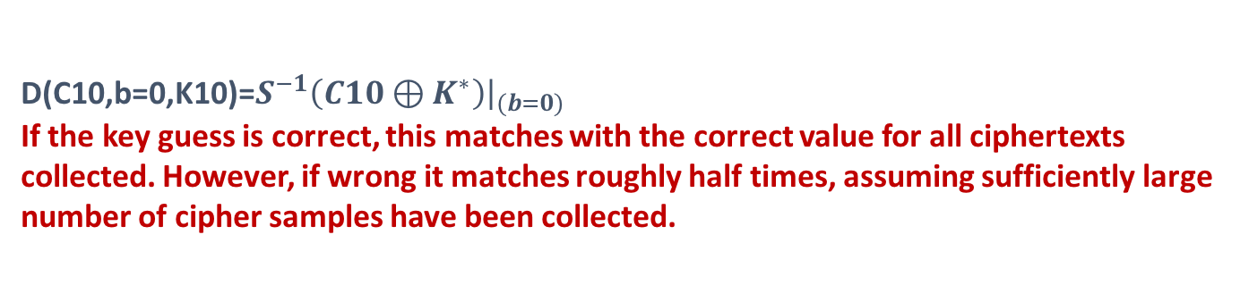
The Selection Function D
Add
Round Keys
+
C10
Sub Bytes and Shift
Rows
Guess k*
??

Slide 12
DPA Mathematically
Attacker now computes a k-sample differential trace Δ_{D}[1..k] by finding the difference between the average of the traces for which D(…) is one and the average for which D(…) is zero.
Principle: If K_{s} is wrongly guessed, D behaves like a random guess.
Thus for a large number of sample points, ΔD[1..k] tends to zero. But
if its correct, the differential will be non-zero and show spikes when
D is correlated with the value being processed.

Slide 13
DPA Results - DES
2D Differential Plot
SBOX – 3 BIT – 3 TRACE COUNT = 4,000

Slide 14
DPA Results - DES

3D Differential Plot
SBOX – 3 BIT – 3 TRACE COUNT = 4,000

Slide 15
DPA Results - Triple-DES

3D Differential Plot
SBOX – 4 BIT – 2 TRACE COUNT = 10,000

Slide 16
DPA Results - AES
3D Differential Plot

SBOX – 11 BIT – 8 TRACE COUNT = 15,000

Slide 17
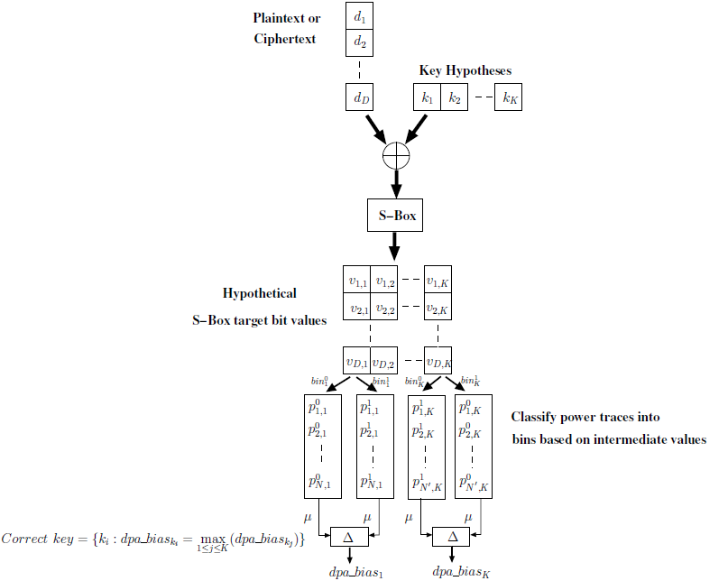
Summary of the DOM based Differential Power Analysis

Slide 18

D. Stinson, Cryptography: Theory and Practice, Chapman & Hall/CRC
Lawrence C. Washington, Elliptic Curves: Number Theory and Cryptography, Chapman & Hall/CRC
Jeffrey Hoffstein, Jill Pipher, Joseph H. Silverman, An Introduction to Mathematical Cryptography, Springer.

Slide 19
Conclusion:
DPA works because of the dependence of power consumption on state bits.
DPA works because of the fundamental way of computation
We discussed about DOM Method.
We applied DOM to a Toy cipher
Applying DOM for AES.

Slide 20


